Slide 1
Data Driven Programming
Getting More Done With Less Code

Slide 2
Class Syllabus
Setup – SAS On Demand for Academics; Download Datasets (20m)
What Is Data Driven Programming? (30m)
Core Techniques
Turning Data Into Code (75m)
Writing Data-Driven Macros (45m)
Program Structure (15m)
Putting it All Together (30-60m)

Slide 3
Getting Started
Notes:
1:10

Slide 4
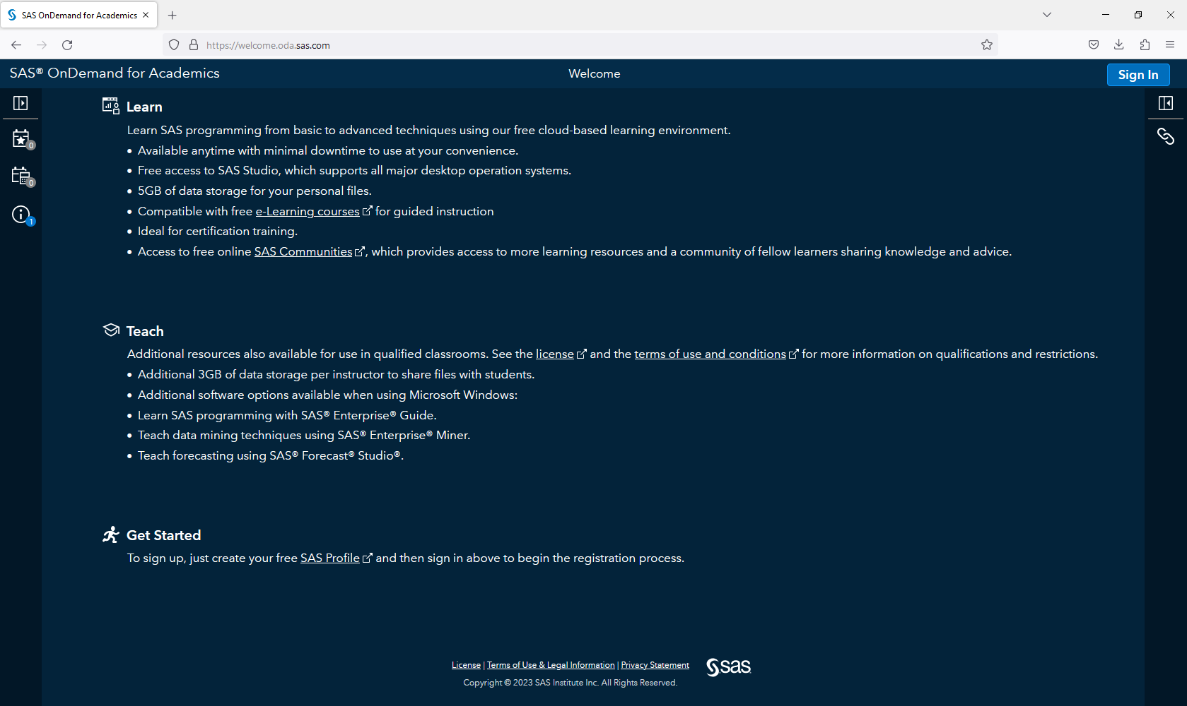
SAS OnDemand for Academics
https://welcome.oda.sas.com/
Requires a SAS account (free)

Slide 5
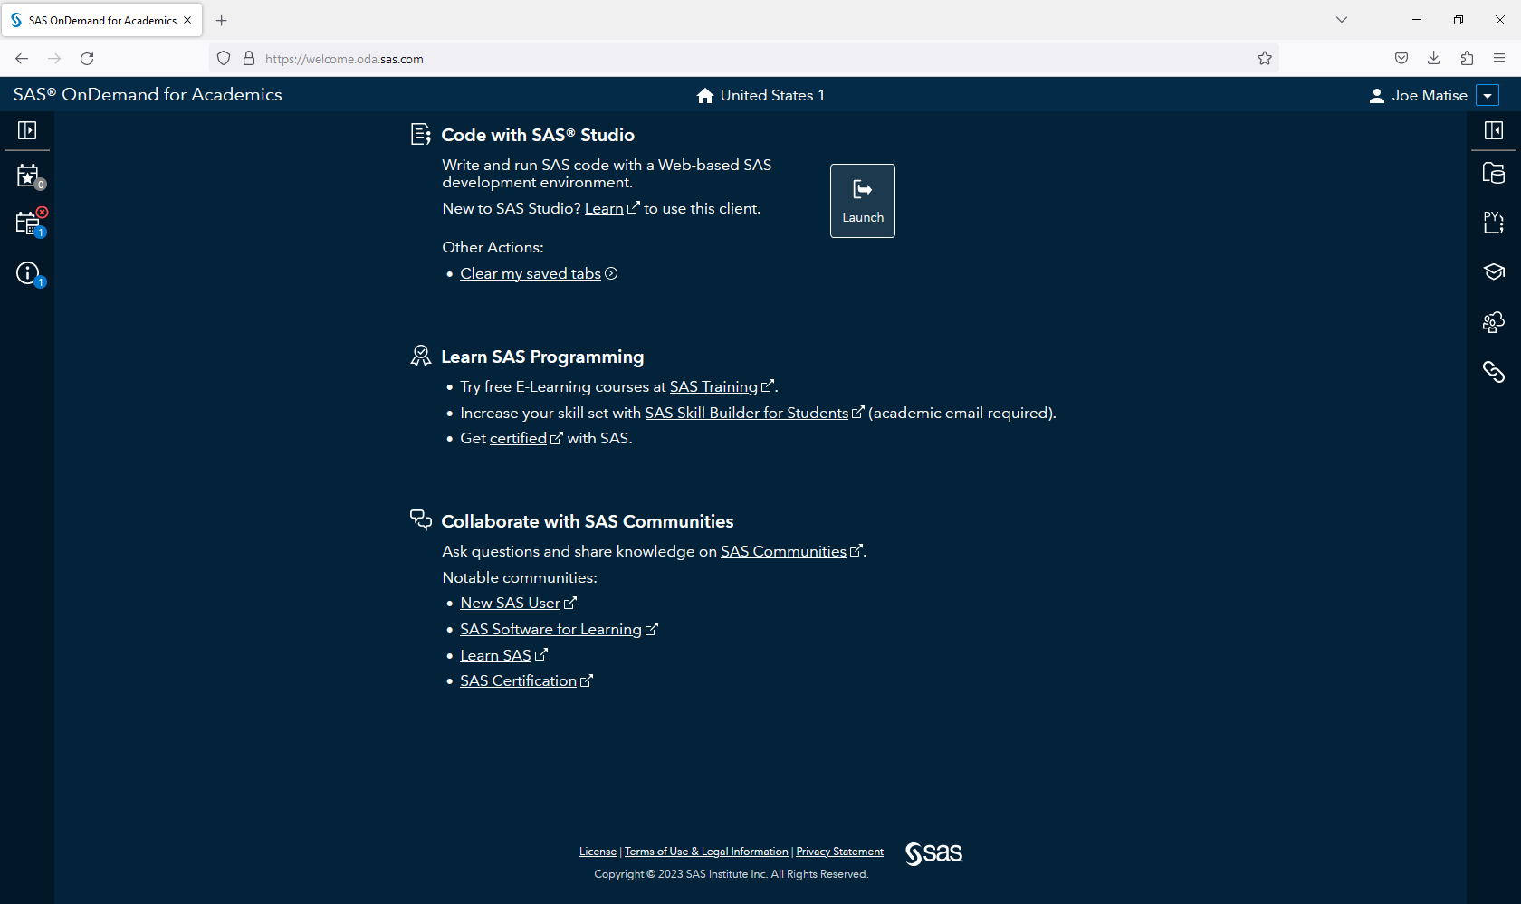
Programming Environment: SAS Studio

Slide 6
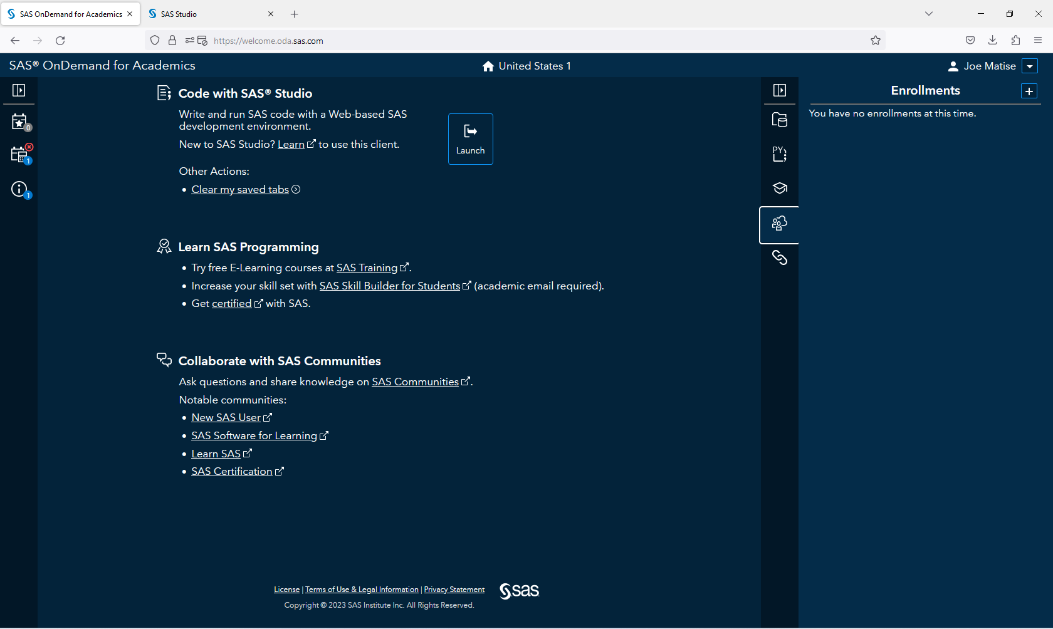
Enroll in Course to download code/data
Course Code:
de82c303-277d-4eff-b4be-fd7ab025ae16

Slide 7
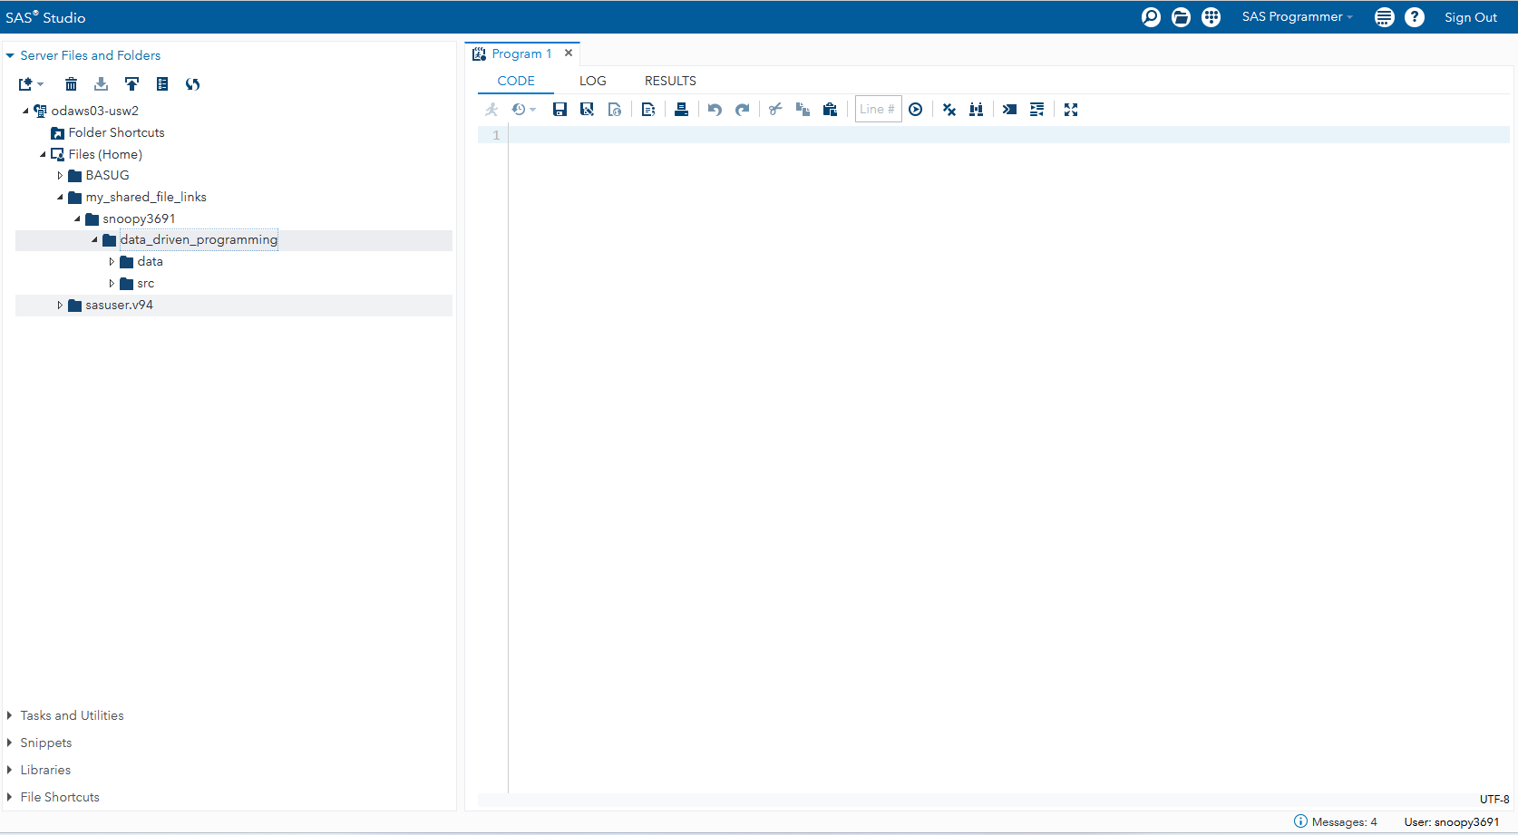
Data and Programs
Find the data and programs in:
~/my_shared_file_links/snoopy3691/data_driven_programming

Slide 8
Data Driven Programming
What, Why, How?
Notes:
1:30

Slide 9
What is Data Driven Programming?
Where possible, uses data that already exists in the organization to drive code
Avoids writing code that contains information – information belongs in datasets
Makes use of the power of SAS to easily integrate data with programming statements

Slide 10
Why Data Driven Programming?
Old Way
Writing code statements based on information
Long, complex programs with many lines of code
Often contains many If/Else statements
Requires updates to code when information changes
Susceptible to errors in transcription
Data-Driven Way
Starts with Data that already exists
Simple, straightforward, short programs
When information changes, programs automatically pick up new information
Simple to maintain, even for non-programmer

Slide 11
How do you practice Data Driven Programming?
Find data sources in your organization
Excel files
Databases
SAS datasets
Identify where in programs that you are using data elements to drive logic
IF/ELSE
Lists of macro calls
Repeated actions where changes are informational elements
Combine these data sources with these places where the data is used, and make it data driven

Slide 12
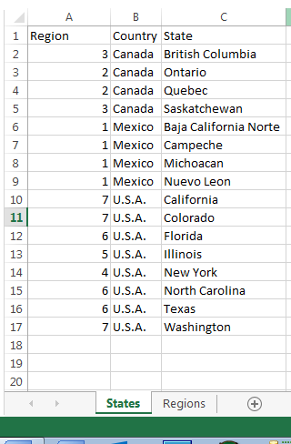
Example: Define regions
Old Way
Data Driven
data prdsal2_regions;
set sashelp.prdsal2;
select(country);
when('Mexico') region=1;
when('Canada') do;
if state in ('Ontario','Quebec') then region=2;
else region=3;
end;
when ('U.S.A.') do;
if state in ('New York') then region=4;
else if state in ('Illinois') then region=5;
else if state in ('North Carolina','Texas','Florida')
then region=6;
...
proc sort data=mydata.states out=states;
by country state;
run;
proc sort data=sashelp.prdsal2 out=prdsal2;
by country state;
run;
data prdsal2_regions;
merge prdsal2 states;
by country state;
run;

Slide 13
Example: Run reports for each region
Old Way
proc report data=prdsal2_regions nowd spanrows;
where region=1;
by region;
format region REGIONF.;
columns prodtype year month actual predict net_projections;
title "Report for Mexico";
run;
proc report data=prdsal2_regions nowd spanrows;
where region=2;
by region;
format region REGIONF.;
columns prodtype year month actual predict net_projections;
title "Report for Eastern Canada";
run;
proc report data=prdsal2_regions nowd spanrows;
where region=4;
by region;
format region REGIONF.;
columns prodtype year month actual predict net_projections;
title "Report for Northeastern US";
run;
Now that’s Data Driven!
%macro run_report(region=, region_name=);
proc report data=prdsal2_regions nowd spanrows;
where region=&region.;
by region;
format region REGIONF.;
columns prodtype year month actual predict net_projections;
title "Report for &region_name.";
run;
%mend run_report;
proc sql;
select cats('%run_report(region=',region,',region_name=',region_name,')')
into :reportlist separated by ' '
from regions;
quit;
&reportlist.
Improved
%macro run_report(region=, region_name=);
proc report data=prdsal2_regions nowd spanrows;
where region=&region.;
by region;
format region REGIONF.;
columns prodtype year month actual predict net_projections;
title "Report for &region_name.";
run;
%mend run_report;
%run_report(region=1,region_name=Mexico);
%run_report(region=2,region_name=Eastern Canada);
%run_report(region=4,region_name=Northeastern US);

Slide 14
Core Data Driven Programming Elements
Method to turn Data into Code
Parameter-driven Macros
Restructuring Programs and Folders

Slide 15
Data Into Code
Core Techniques
Notes:
2:00

Slide 16
Transforming Data Into Code: Overview
Many different methods for writing code from data
Differences:
Limitations
Execution Timing
Simplicity
Permanence
Combine different techniques for best results

Slide 17
Data Into Code: Options
PROC SQL Select Into
Create a text file, then use %include
CALL EXECUTE
DOSUBL
SAS Formats
Macro variable arrays

Slide 18
Data Into Code: PROC SQL SELECT INTO
Limitations: 64000 characters or less
Timing: avoid using inside a macro
Simplicity: Very simple, shortest code
Permanence: Impermanent, but generates readable output

Slide 19
Data Into Code: Write Text File
Limitations: Disk space available
Timing: Can only be used where %include is permitted
Simplicity: Moderate complexity, fairly long code length
Permanence: Permanent if desired

Slide 20
Data Into Code: CALL EXECUTE
Limitations: 64kb per statement (but can run one or more statements per line)
Timing: Run during data step, so can have complex macro variable interactions
Simplicity: Fairly simple
Permanence: Impermanent, but can write to log

Slide 21
Data Into Code: DOSUBL
Limitations: Memory (this can consume a fair amount of RAM)
Timing: Run during data step, but separately, so simpler macro variable interactions
Simplicity: Fairly complex
Permanence: Impermanent, does not log output

Slide 22
Data Into Code: Formats
Limitations: Memory, can perform poorly at >1M rows, can only transform 1:1
Timing: Simple (run outside of data step)
Simplicity: Moderate
Permanence: Impermanent, does not log output

Slide 23
Data Into Code: Macro variables/variable arrays
Limitations: Macro variable maximums; largely only usable in a macro loop.
Timing: Only in macro, so instant inside that.
Simplicity: Complex
Permanence: Impermanent, does not log output.

Slide 24
Macros with Parameters
Core Techniques

Slide 25
Macros with Parameters: Basics
Macros with parameters allow us to pass data values to a macro
Even if your code is not primarily macro-based, this simplifies code and improves readability
Passing data to macros via parameters, rather than global variables, is safer and more self-documenting.
Macro parameters are treated similarly to local macro variables inside that macro.

Slide 26
Macros with Parameters: Build Strategy
First, write the code without any macro variables or parameters, with one single set of values hardcoded.
Second, rewrite the code by removing all hardcoded values and writing them as macro variables, with %let statements prior to the code for each.
Finally, wrap the code with %macro/%mend, and create one parameter for each macro variable.

Slide 27
Organizational Strategies

Slide 28
Best Practices: Organizational Strategies
Separate code and data into different folders
Write each separate piece of code in a separate file to allow for unit testing
When possible, make each piece of code possible to execute standalone
Include a config or environment file to define libnames, parameters, etc. in all programs when commonly used in many programs
For macros, write them in separate program files and include an example test in the macro program in comments

Slide 29
Unit Tests
Unit tests verify that each piece of a program does what it is supposed to when executed by itself
For Data Driven Programming, this is key – each piece must function or the whole program will fail.
Unit tests can be formal (code that executes and verifies its results, logs its results, etc.) or informal (code that can be executed by hand, and verified manually).
Organized unit testing can be valuable for complex sets of programs, but even simple manual checks can be a significant value add for simpler programs!

Slide 30
Exercises

Slide 31
Exercises
1. Create a dataset from school_districts that a STATE_NAME column based on FIPS_STATE.
2. Create a dataset from step 1 that also has the REGION column populated from the regions dataset
3. Create a bar chart (or similar graph) for each region that has a bar for each state in the region showing children in poverty in that state, named with STATE_NAME

Slide 32
Exercises
4. Create a report for each state showing the proportion of children in poverty to total school-aged children for each district in that state
5. Generate rules for each state, defining high-medium-low school districts based on the criteria from 4
6. Apply these rules from 5 to the dataset, giving a H, M, or L value in a column for each district.
7. Generate a report for each state showing districts in high/medium/low categories.

Slide 33
Thank you!
Contact: matisejoe@gmail.com
Github: https://github.com/snoopy369/presentations

